Slide 1
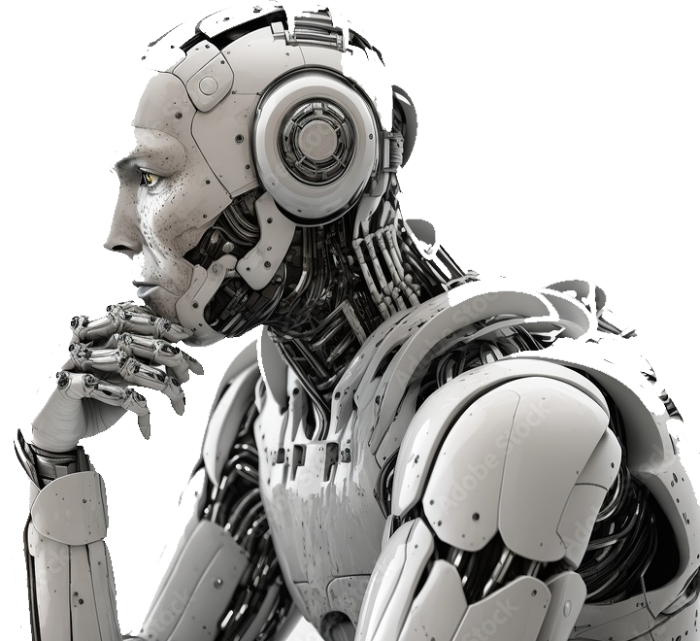
How AI is expected to change the role of the Safety Manager in Trucking
APTA / MMTA
2024 Safety Council Discussion
Nick Michaud, Midland Transport
Shawn Reilly, Sunbury Transport / RST Industries
Notes:
Speakers Notes: Shawn to Introduce both Nick and Shawn and thank everyone for participating today.
Overview:
This presentation structure covers the main aspects of how AI has changed the role of safety professionals in the trucking industry, highlighting both the benefits and challenges of this technological shift.
Table of Contents:
Shawn: Pre-AI: The Stone age of trucks, a historical perspective on the role of the safety manager B.A.I. (before A.I.) and the dawn of the information age.
Shawn: the 4th industrial revolution and how this has changed the trucking industry. Sensors, data, truck technology around risk (ELDs, cameras, etc.)
Nick: How the Pandemic (Covid) forced safety managers to adapt or die. The changing ways we communicate with the workforce.
Nick: New World Safety. Single pane safety management, Generative AI, risk management and challenges. What is next for AI use in the trucking industry

Slide 2
In The Beginning…
To know where you’re going… you need to know where you’ve been.
The internal combustion engine was technically invented in 1884, but the gasoline-powered internal combustion engine didn’t become an economic and cultural force until the 1910’s
WWI – the revolution of people and goods movement
By 1924 nearly 3 million trucks were in use across the US.
Over the past 100 years, the Trucking industry has been transformed into what we know (and love) today...
1913 – the first Canadian interprovincial trucking run between Winnipeg and Regina. The trip took 4 days to complete. Today, the same 582 Km trip takes 6-7 hours.
Notes:
Slide Opens: So Nick and I have decided that we are going to share this discussion with you today because, as he puts it, I have been around long enough to remember “old school” safety and have the gray hair to prove it while he is young and smart and understand the “new school”. So I guess that’s why I get to start off with a picture of my first truck…
First click: and some old typewriter font just to give the older generation in the room some “presentation PTSD.”
In all seriousness though, to understand the journey we want to take you on during this discussion today, we should first understand where we came from. Commercial transportation has come a long way since the days of using canals, carriages, and horses to move goods from one point to another. As some of you may know, modern trucking has its true beginnings in the late 1800’s and was primarily dominated by steam engine vehicles and horse drawn vehicles. The steam engine was in use all the way up to the first world war when the French and British used the first combustion engine trucks for moving supplies and ammunition to supplement both horse transport and light railways, and for emergency movement of troops. After WWI a new industry was born as horses could only travel up to 32 kms per day to deliver goods whereas the combustion engine trucks could travel up to 130 km in a single day! This meant expanded markets for fresh produce, cured meats, fish, and dairy products all across North America.
It didn’t take long for this new industrialized movement to catch on. Between 1918 and 1924 the production of nearly 3 million trucks entered the North American workforce. Lets let that since in for a moment. The industry we know and love is just a little over 100 years old this year.
Second click: and for all the Canadians in the room here is a fun fact… The first interprovincial route for any combustion engine truck took place in 1913. That first trip took 4 days to complete and traveled 582 km. The point is… our industry, in the grand scheme of our industrialized workforce, is still relatively young.

Slide 3
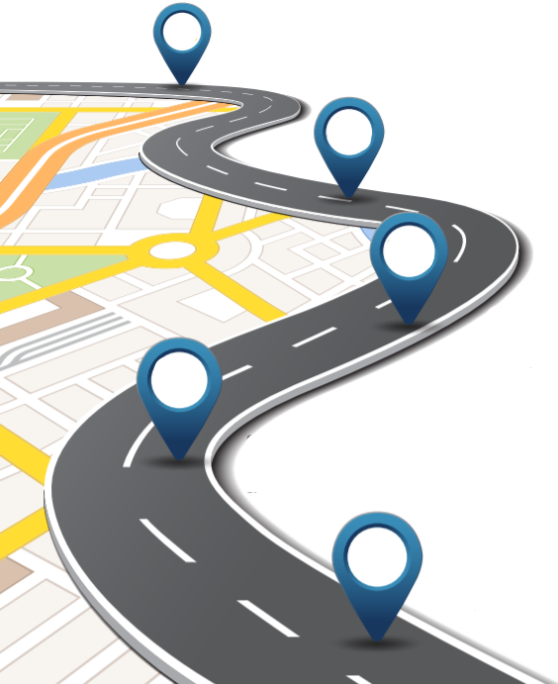
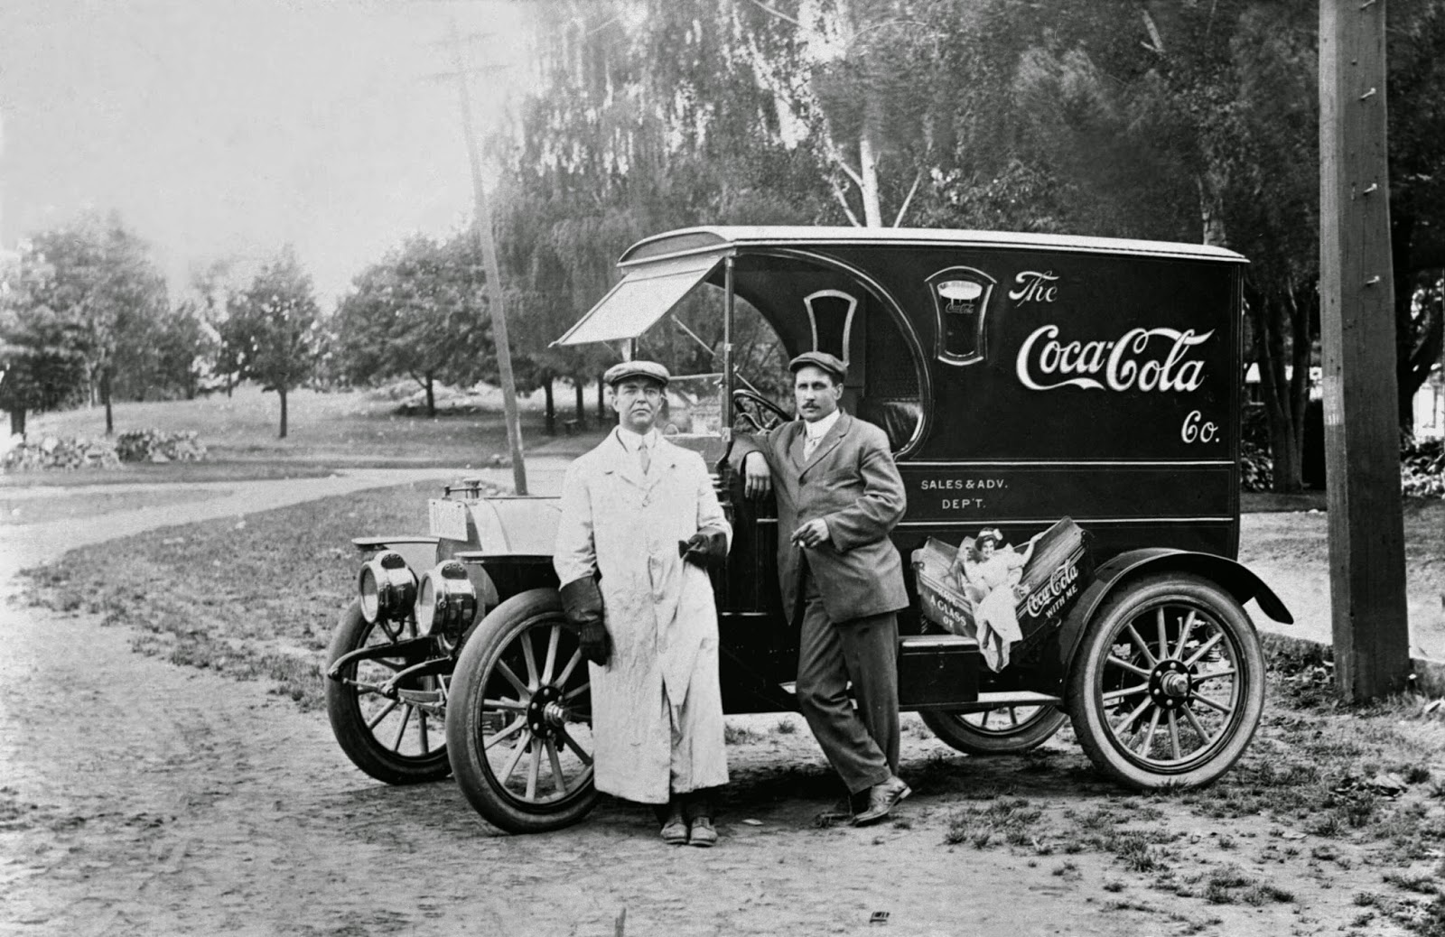
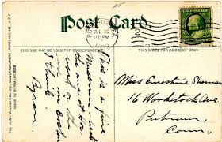
June 2021 (Canada) / Dec 2017: ELD mandates – * First truly disruptive technology mandates!
The role of safety in Trucking
Compliance, Safety, Accountability 2010
USA Patriot 2001 / 2007
Motor Carrier Safety Improvement Act 1999: Established the FMCSA with the goal of accident prevention
Omnibus Transportation Employee Testing Act 1991: Established DOT Drug and Alcohol testing programs
The Birth of the “modern” Trucking Safety Manager
National Safety Code 1987: Canadian rules established to create a uniform set of safety rules across Canada, improve cross border trade.
CMVSA 1986: Established qualification, medical and licensing standards for CMV drivers and carrier safety standards.
Motor Carrier Act 1935. Created the DOT, ICC and enacted several laws (including first HOS) to ensure commercial carrier safety. First regulation created after the great depression
Notes:
First click: In the early days of trucking there were very few regulations and no real role for safety managers like us. Government in fact didn’t create the first real “rules” until 1935 in the US. This Motor Carrier Act was the first really comprehensive set of rules set out by the government to dictate how motor carriers were expected to register and operate safely. From a safety perspective not a lot of changes happened for the next 50 years…
By the late 80s, two significant changes fundamentally changed the industry. The first was the Commercial Motor Vehicle Safety Act in the US and the second (similarly) was the adoption of the National Safety Code in Canada. These two pieces of legislation set up most of the same rules and requirements we manage today. Additionally, the concept of driver (operator) training really started to rise, and the benefits were very apparent. Drivers had to complete training to obtain a license including safe driving techniques and understanding all the components of the vehicle. This was the start of the discussions we heard earlier today with our driver training panel.
Additional improvements and legislation continued in the 90’s with the US D&A rules which Marilyn spoke about earlier today and established the modern-day FMCSA in the US we will hear about later today. And of-course we have seen significant changes in recent years to our industry due to security programs implemented under the US Patriot act, safety changes with the FMCSA’s CSA program and the first “technology” regulations that impacted our industry with the introduction of Electronic Logs.
Second click: Clearly there has been a lot of other innovations in the industry in the last 100 years but these key regulatory milestones events really set the stage for what we know as the “birth of the modern truck safety manager”. You all know who this person is right? (advance slide)

Slide 4
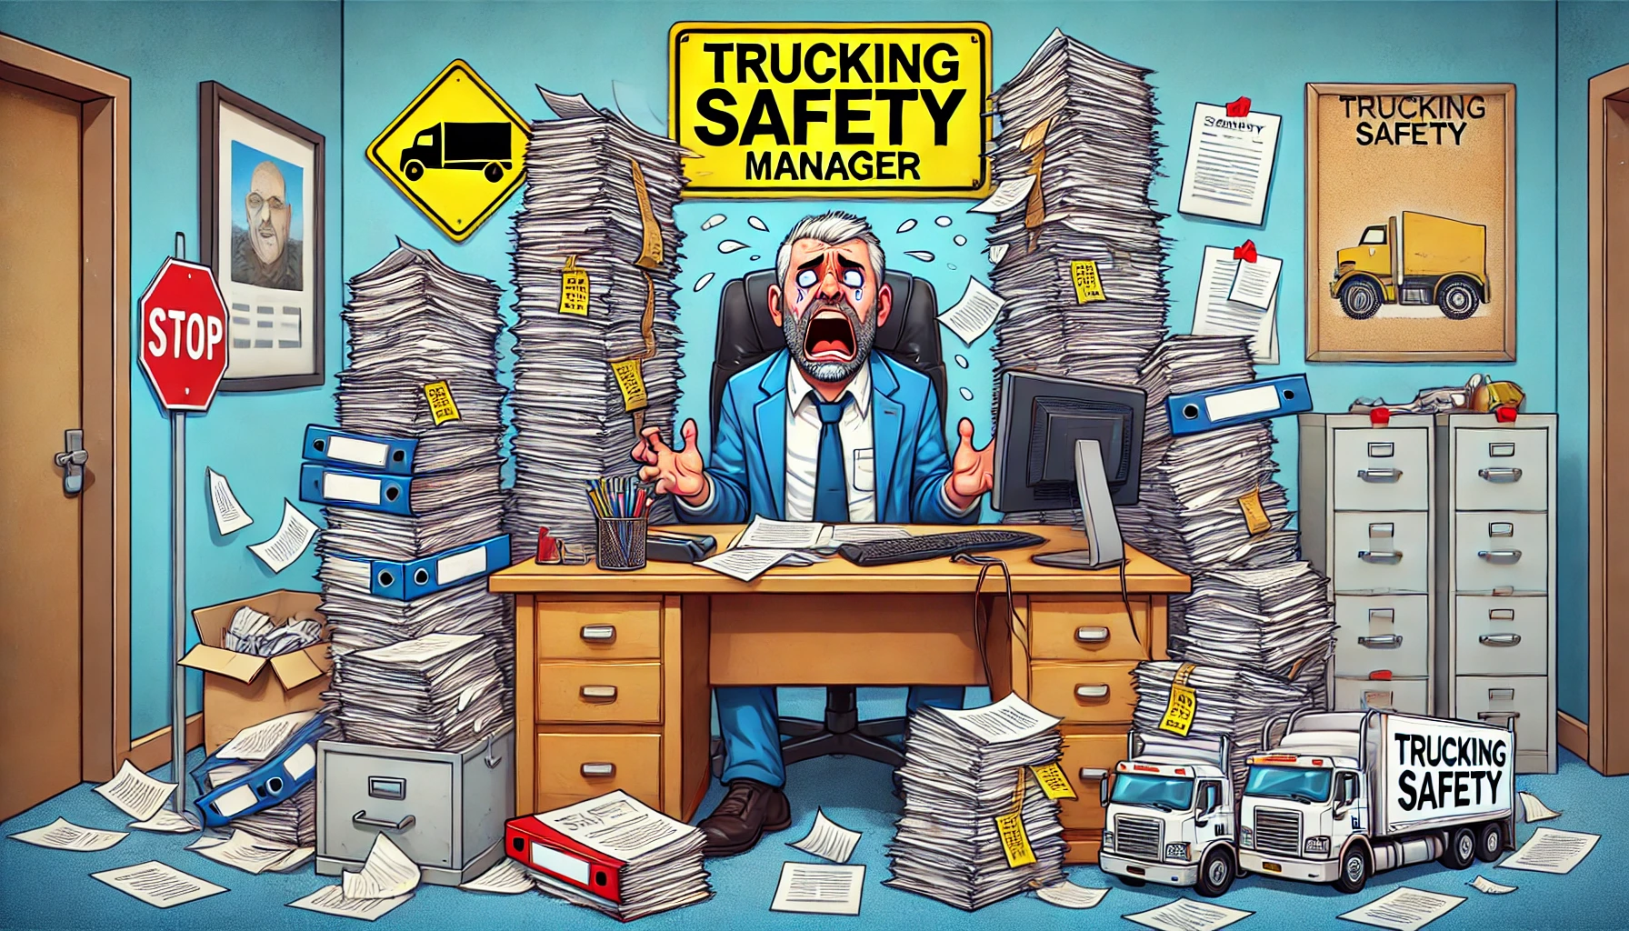
DOT Audit…
Coming Soon
Traditional Fleet Safety Program
Notes:
We all remember that guy or gal, don’t we? Looked a little like this…. A lot of manual processes and buried in paperwork. Worried as much about the regulator and compliance as we were about developing and training good drivers. When we talk about “old school safety practices” this is what most of us think of.
Key Responsibilities of this safety manger?
Compliance: Monitoring and enforcing safety regulations (and policies) to ensure compliance with laws. Conducting safety audits, vehicle inspections, and maintaining accurate records of HOS, incidents and training. This was very much (and maybe still is) a time of reactive enforcers.
Education: Providing classroom or in cab / in yard driver training. Lots of observations in the field. Lots of miles on your vehicle meeting drivers “where they work”.
Managing Lagging Indicators / Investigation: Investigating accidents, analyzing causes, and reporting findings to improve future safety. Measuring the “effectiveness” of our safety programs through DOT Accident registers, OSHA Recordable injury rates or incidents per million miles.
For many of us, there are still many elements of this old school safety program in place today. This presents a number of challenges:
Reliance on manual data collection and analysis, which is time-consuming and prone to human error.
Reactive approach to safety, often addressing issues only after an incident occurs.
Limited ability to monitor driver behavior and vehicle conditions in real-time, leading to delayed responses to potential hazards, compliance and training needs which resulted in having a limited impact on changing safe behaviours.
If ONLY THERE WAS A BETTER WAY. This Manager needs help!

Slide 5
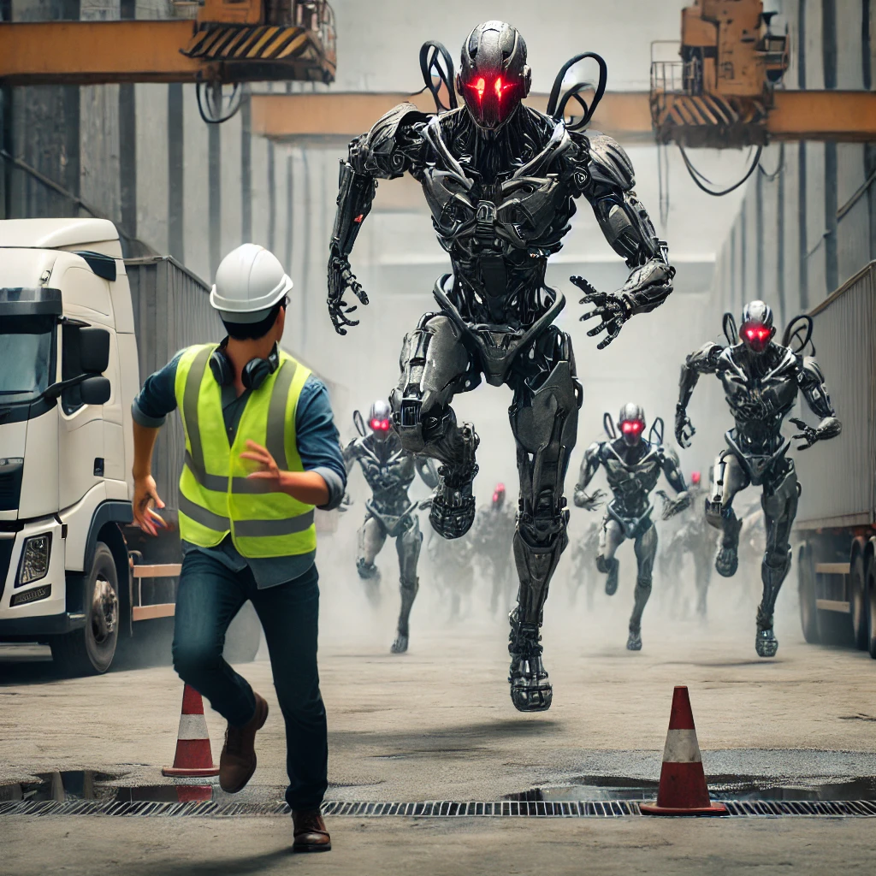
All we every wanted was a little bit of help. Why could the “computer age” not make our jobs easier, You know, like all those movies in the 80’s and 90’s promised us…
Notes:
Slide Opens: Why could the “computer age” not make our jobs easier, You know, like all those great Sci Fi movies in the 80’s and 90’s promised us? You know the ones, Terminator, RoboCop, Ghost In The Shell, The Matrix. I, Robot?
Throughout the computer age, safety managers like us and regulators alike spent years looking for a better way to manage compliance, automate processes to reduce our reliance on paperwork to make all of our jobs a little easier but mostly make our roles more efficient.
First click: These movies also taught us that, even if the computer age could save the world, if we were not careful those same machines could overrun it. Remember terminator? Well… turns out maybe Skynet did become self aware, just maybe not quite the way we thought it may have…
As a side note, this is what you get when you ask generative AI to give you a picture of a “terminator like robot invasion chasing a safety manager in a trucking company”.

Slide 6
2011
Disruptive Technologies Drive Creative Destruction”
Creative Destruction is at the core of all innovation that drives society to achieve previously unimaginable achievements
Notes:
Then, in 2011 - The DAWN of the 4th Industrial Revolution arrived! Artificial Intelligence became mainstream for the first time. AI is a “disruptive technology” meaning an innovation something that changes in the way humans perceive and interact with the world around us.
Not all innovations are disruptive, even if they are revolutionary. For example, the first automobiles in the late 19th century were not a disruptive innovation, because early automobiles were expensive luxury items that did not disrupt the market for horse-drawn vehicles. The market for transportation essentially remained intact until the debut of the lower-priced Ford Model T in 1908. The mass-produced automobile was a disruptive innovation, because it changed the transportation for the world as we knew it whereas the first thirty years of automobiles did not. Remember the rise of trucking? This came about because of global events due to the first world war and changed forever the way we view the movement of people and goods… but this was not “mainstream” until the mid 1920’s.
Today however we see something different… we see Artificial Intelligence or AI ushing in a “new age” of industrial revolution unlike anything we have seen before… what we know as the 4th industrial revolution.

Slide 7
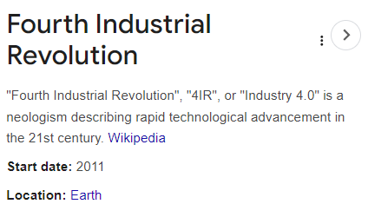
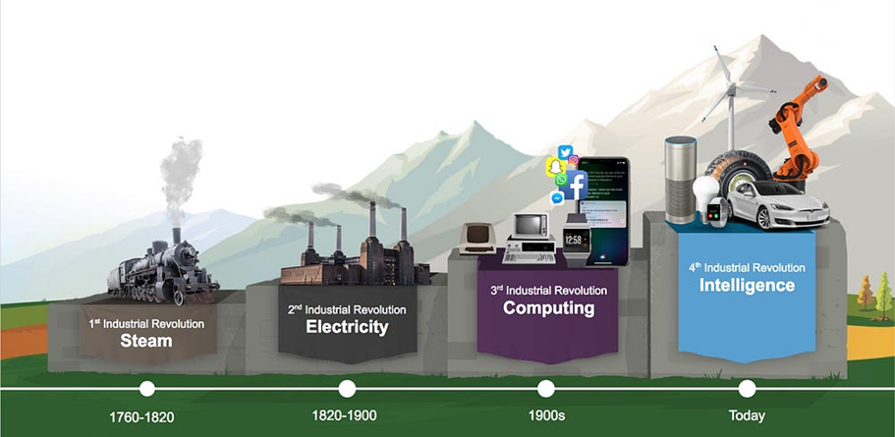
Notes:
The Fourth Industrial Revolution", "4IR", or "Industry 4.0" is a term describing rapid technological advancement in the 21st century and is a unique shift from what we have experienced in the “computer age” over the last 3 decades. The term was popularized in 2016 by the World Economic Forum who assert that these developments represent a significant shift in in how global production and supply chain networks operate through ongoing automation of traditional practices using “smart technology”.
4IR represents a social, political, and economic shift from the digital age of the late 1990s and early 2000s to an era of embedded connectivity distinguished by the daily use of technology in society that changes the ways humans experience and know the world around them. So, what doers this have to do with us in our profession today? This transition has happened more rapidly than any of the other industrial revolution stages in our recorded history and fundamentally impacts the way we work, live and interact and it has significant impact on our roles and our industry in trucking as well.

Slide 8
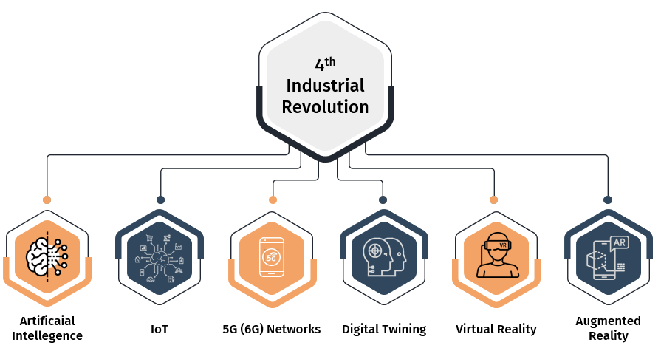
What is the “4th Industrial Revolution” … and what does it have to do with us?
Notes:
Before we talk about how this is influencing our industry today, lets define what makes up this concept.
Let’s start with Artificial intelligence. AI is the science of making machines that can think like humans. It can do things that humans considered "smart.“ A simple example might be when Siri or google tells you your local forecast today. When people are asked about AI, they're usually thinking of Hollywood blockbusters like the movies mentioned earlier. The reality however is AI simply is the use of computers to process vast amounts of data in ways humans cannot. Think of Google nest, Alexa and Siri. These are all simple AI platforms. They recognize patterns, make decisions and judge results based on inputs (from you). More advanced AI is being developed all the time like ChatGPT4. AI is at the very foundations of some things, like image recognition and classification. It's also changing how we make decisions - for example, it can be used to predict – based on data WE feed it – who is most likely to have an at fault accident.
Machine learning: is often coupled with any discussion around AI but is a little different. ML is a subset of AI and is the science of getting computers to learn and act as humans do. It is what we can call “training” the AI algorithm to then produce output. If a computer is given input data (i.e. accident stats, employment history, violations, telematics data) with the corresponding output data (preventable accidents) so it can learn the algorithm itself can continue to predict the right output data. To get more precise we need vast amounts of data. This is what you may have heard called “big data”. A practical real-world example of this is “Recommendations are powered by machine learning” for Google, Netflix, YouTube and Amazon. These same principles also apply to Facebook and Instagram ads.
Deep Learning: Deep learning (DL) is the most advanced (today) version of AI and allows computers to process, interpret and make use of far larger and more complex data sets. Deep learning mimics the workings of our human brains. Data is processed through multiple layers and eventually, with enough training data, these neural networks can outperform humans at intelligent tasks like speech recognition or playing chess! Whereas machine learning has a simple “if this, then that” mechanism, deep learning has “if this, then that, then what about (x)?” on repeat. In other words, machine learning can ask and answer one question, and then requires human intervention. This is the basis of ChatGPT4. Deep learning will ask and answer one question — but then, based on that answer, ask another question, and answer it, and so on and so forth. Deep learning is the most advanced and sophisticated AI technology. For example, it enables Google to give you a search result that's tailored specifically for your needs - not just something they think everyone may want to know about. In insurance, deep learning helps to figure out the damage when cars get in traffic accidents. This is possible because deep learning can teach a computer how to identify damaged car parts, make predictions about how much it will cost for repairs, and make estimates about what will happen.
Internet of Things: (IOT) The Internet of Things describes the network of physical objects—“things”—that are embedded with sensors, software, and other technologies for the purpose of connecting and exchanging data with other devices and systems over the internet. These devices range from ordinary household objects to sophisticated industrial tools. There are more than 8 billion “things” connected IoT devices today. In safety this would be considered wearables such as gas monitors, sensors on trucks etc. While the idea of IoT has been in existence for a long time, a collection of recent advances in a number of different technologies has made it practical.
Access to low-cost, low-power sensor technology. Affordable and reliable sensors are making IoT technology possible for more manufacturers.
Connectivity. A host of network protocols (5G and 6G networks) for the internet has made it easy to connect sensors to the cloud and to other “things” for efficient data transfer.
Cloud computing platforms. The increase in the availability of cloud platforms enables both businesses and consumers to access the infrastructure they need to scale up without actually having to manage it all.
Machine learning and analytics. With advances in machine learning and analytics, along with access to varied and vast amounts of data stored in the cloud, businesses can gather insights faster and more easily. The emergence of these allied technologies continues to push the boundaries of IoT and the data produced by IoT also feeds these technologies.
Conversational artificial intelligence (AI). Advances in neural networks have brought natural-language processing (NLP) to IoT devices (such as digital personal assistants Alexa, Cortana, and Siri) and made them appealing, affordable, and viable for home use.
5G Networks: 5G is the fifth generation of wireless cellular technology, offering higher upload and download speeds, more consistent connections, and improved capacity than previous networks. 5G is much faster and more reliable than the currently popular 4G networks and has the potential to transform the way we use the internet to access applications, social networks, and information. For example, technologies like self-driving cars, advanced gaming applications, in cab cameras and other communications devices, and live streaming media that require very reliable, high-speed data connections. The demand for internet access, combined with the emergence of new technologies such as artificial intelligence, the Internet of Things (IoT), and automation, are driving a massive increase in the amount of data created. Data creation is growing exponentially, with volumes set to increase by several hundred zettabytes over the coming decade. The current mobile infrastructure was not designed for such a high information load and requires upgrading. 5G could help to support and scale several applications like cloud-connected traffic control, drone delivery, video chatting etc.. From global payments and emergency response to distance education and mobile workforce, the benefits and applications of 5G are limitless. It has the potential to transform the world of work, the global economy, and people's lives.
Digital Twinning: A digital twin works by digitally replicating a physical asset in the virtual environment, including its functionality, features, and behavior. A real-time digital representation of the asset is created using smart sensors that collect data from the product. You can use the representation across the lifecycle of an asset, from initial product testing to real-world operating and decommissioning.
Digital twins use several technologies to provide a digital model of an asset including AI, ML, IOT and rely on 5G for information processing.
Virtual Reality: Virtual Reality (VR) is a computer-generated environment with scenes and objects that appear to be real, making the user feel they are immersed in their surroundings. This environment is perceived through a device known as a Virtual Reality headset or helmet.
And finally, Augmented Reality: Augmented reality is an interactive experience that enhances the real world with computer-generated perceptual information. Using software, apps, and hardware such as AR glasses, augmented reality overlays digital content onto real-life environments and objects.
These 6 tools all make up what we know today as the Intelligence age.

Slide 9
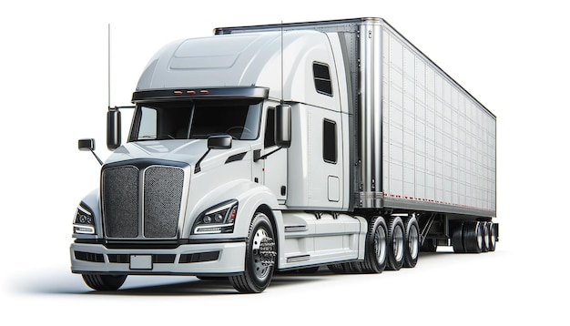
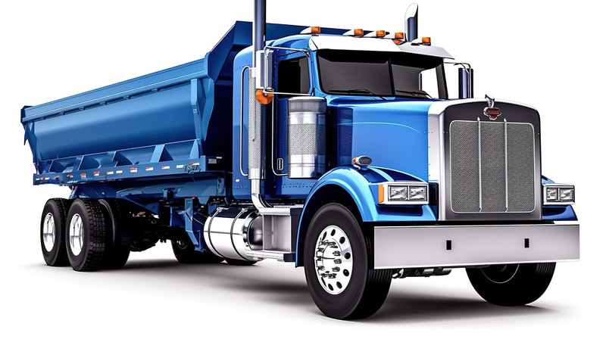
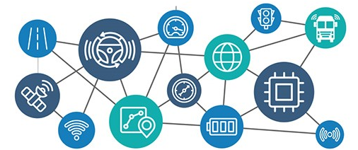
The “4th Industrial Revolution” and Trucking
Signals
Fault Code maintenance alerts
Idle Fuel Gallons
Moving Miles/Gallon
Engine Torque
Engine Power
Moving Time
Distance
Top Gear %
Hard Brake events
Throttle Position
Vehicle Speed
GPS Position
Onboard Safety Systems
Detroit Assurance (ADAS)
Active Speed Intervention
Brake Assist
Brake Hold
Adaptive Cruise
Lane Assist
Lane Departure Warning
Automatic wiper / lights
Roll Stability
Comet (tire / hub sensors)
Event Recorder
Lane Departure
Critical Distance
Rolling Through Stop Sign
Close Following
Driver Behaviour
Trailer
GPS Position
Cargo Sensor (% full)
Humidity
Temperature
Door open/close
Scully Systems
Product sensors
ABS / Antirollover
Satellite Technology
GPS tracking
Critical event (harsh braking / speed)
Workflow AI
Smartdrive IoT
Fault Monitoring
Augmented and Virtual Reality
Notes:
And while this may still sound like science fiction to some of us… this is already embedded in our industry today. Take a look at the screen here. There are hundreds of different applications in place in most of our fleets today that take advantage of all 6 of the technologies we just mentioned. We use sensors to receive massive amounts of sate, onboard systems to improve safety and predictability, positioning and tracking systems and augmented and virtual reality can transform the training industry.
In 2019 truck news conducted a Canada wide survey of the trucking industry to look at what technologies the Canadian Trucking industry were using and wanted to see more of from an “emerging technologies” perspective. At that time… yes, only 5 short years ago… more than half the industry responded that technologies were making the industry safer in most situations. Thirty-four percent expected to see the widespread use of Level 4 automation – trucks that essentially drive themselves – in 11 to 20 years and now that technology is closer than ever to adoption IF jurisdictions don’t outright ban “driverless trucks”.
The latest advancements we see in the industry which are widespread today is Advanced Driver Assistance Systems or ADAS. ADAS use IOT and advanced sensors focusing on enhancing driver safety, improving vehicle efficiency, and reducing the potential for accidents. These advancements, coupled with next generation electric, hybrid, hydrogen or other next gen fuel trucks are also advancing at breakneck speeds.
We are more connected now than ever before to our “assets” and they are more connected than ever before to the driver’s actions behind the wheel in real time. The question we have to ask is… Does this make us more connected to our people, or less connected?

Slide 10
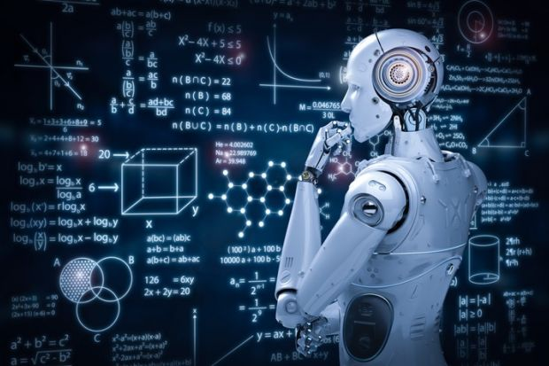
Data Driven Decision Making
Notes:
What all this disruptive, and transformative, technology has led to is a concept we know as “Data Driven Decision making”. Using hundreds of thousands of data points to make the same decisions as that poor safety manager buried in paperwork that we discussed a while ago. This information age has transformed the role of that safety manger to that of a “modern safety data manager”.
And it is at this point I want to turn this presentation over to Nick to look at what the modern role of this manager looks like.

Slide 11
The Impact of the Pandemic on Workplace Communications

Slide 12
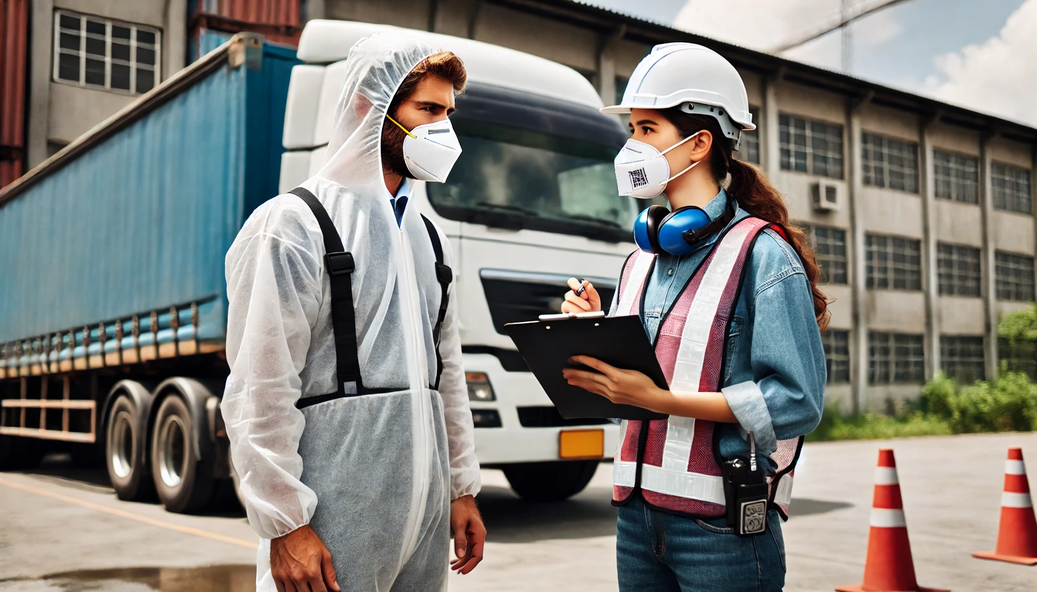
Safety Managers… What did we learn during the Pandemic
Notes:
Everybody remember this (reference slide) COVID? The Pandemic? Lockdowns, Masks & Social distancing.
What a crazy time.
We were forced to adapt; We were faced with a challenge. How can we continue operations safely while also limiting face to face interactions.
The pandemic dramatically altered the way the trucking industry communicated & inevitably accelerated the adoption of technology.
1. Digital Communication Tools:
The first example of this was the increased use of digital communication tools. Like zoom & Microsoft teams. With in-person meetings disrupted by social distancing, the industry quickly embraced digital platforms.
2. Virtual Training and Safety Briefings
Before the pandemic, many companies held in-person safety meetings, training sessions, or briefings. As restrictions on gatherings emerged, there was a shift to virtual meetings.
Webinars and Online Training: Safety and compliance training moved online, allowing drivers to attend from anywhere. This was critical for maintaining safety standards while reducing the risk of virus exposure.
Video Conferencing: Platforms like Zoom, Microsoft Teams, and Google Meet were used for meetings with drivers, replacing traditional in-person interactions. Safety managers and dispatchers could conduct briefings or check-ins virtually.
Impact: Virtual training sessions became more flexible, allowing drivers to complete their training on their own schedules, which increased overall efficiency.
3. Contactless Documentation and Transactions
To reduce physical contact and the handling of paperwork, trucking companies accelerated the adoption of contactless processes, which helped to streamline communication.
Electronic Logging Devices (ELDs): ELDs, which had already been implemented prior to the pandemic due to federal regulations, became more crucial during COVID-19. These devices track driving hours and communicate with dispatchers, reducing the need for in-person logbook checks.
Digital Document Sharing: Drivers could now submit bills of lading, delivery receipts, and other essential documents via mobile apps, reducing the need for face-to-face interactions and physical paperwork exchanges. Digital signatures became more common, enabling contactless deliveries.
Mobile Payment Systems: Many companies adopted mobile payment solutions, allowing drivers to process payments without handling cash or checks.
Impact: Contactless communication and transactions reduced the risk of virus transmission while streamlining workflow, making these practices a permanent fixture even after the pandemic.
4. Telemedicine for Driver Health
One of the critical challenges during the pandemic was ensuring drivers had access to medical care, especially since they spent long hours on the road. Telemedicine services were quickly adopted to provide healthcare remotely.
Telehealth Consultations: Drivers could access medical professionals for consultations, mental health support, and other health services via video calls or phone calls. This allowed them to get the care they needed without having to visit medical facilities in person, which might have been risky or challenging to access due to restrictions.
Impact: Telemedicine not only improved access to healthcare but also helped keep drivers safe and healthy during the pandemic, fostering better communication between drivers and healthcare providers.
5. Automation and AI Integration
The pandemic accelerated the use of AI and automation tools to help improve communication and reduce human contact.
Automated Dispatch Systems: AI-powered dispatch systems became more popular, automatically sending route updates or instructions to drivers based on real-time data. These systems allowed drivers to receive information without the need for human intervention, streamlining the communication process.
AI Chatbots: Some companies adopted chatbots to answer frequently asked questions from drivers, freeing up dispatchers for more complex queries.
Impact: Automation reduced the need for direct communication between drivers and dispatchers, increasing efficiency and allowing for quicker responses to common queries.
6. Focus on Mental Health and Well-being
The isolation and stress caused by the pandemic made the mental health of truck drivers a critical issue. As a result, more trucking companies started offering mental health resources and promoting open lines of communication.
Mental Health Hotlines and Support Groups: Some companies set up hotlines and mental health support resources specifically for truck drivers, recognizing that long periods of isolation and the pressures of delivering essential goods could take a toll.
Wellness Check-ins: Communication with drivers expanded to include wellness check-ins, where dispatchers or managers regularly checked on how drivers were doing emotionally and mentally.
Impact: Companies became more mindful of their drivers’ well-being, fostering a more supportive and communicative work environment.
7. Enhanced Safety Protocols and Communication
During the pandemic, frequent updates on health guidelines, safety protocols, and government regulations became necessary. Truck drivers needed real-time updates on changing conditions, such as restrictions, quarantine rules, or the availability of truck stops and rest areas.
Real-Time Alerts: Dispatchers used digital platforms to send real-time alerts about safety protocols, regulatory changes, or travel restrictions due to COVID-19, keeping drivers informed and ensuring compliance.
Health and Safety Monitoring: Some companies implemented systems for tracking driver health, including monitoring temperature checks and symptom reporting through apps.
Impact: More frequent communication around safety helped drivers stay informed and adhere to health guidelines, creating a safer work environment.
Conclusion:
The pandemic reshaped how trucking companies communicate with drivers by accelerating the adoption of digital tools and creating a more connected, real-time communication infrastructure. Safety, efficiency, and remote management became the new priorities, permanently altering the trucking industry's approach to driver communication. Many of the tools and practices adopted during the pandemic—such as digital platforms, contactless transactions, and telemedicine—will likely remain part of the industry moving forward.

Slide 13
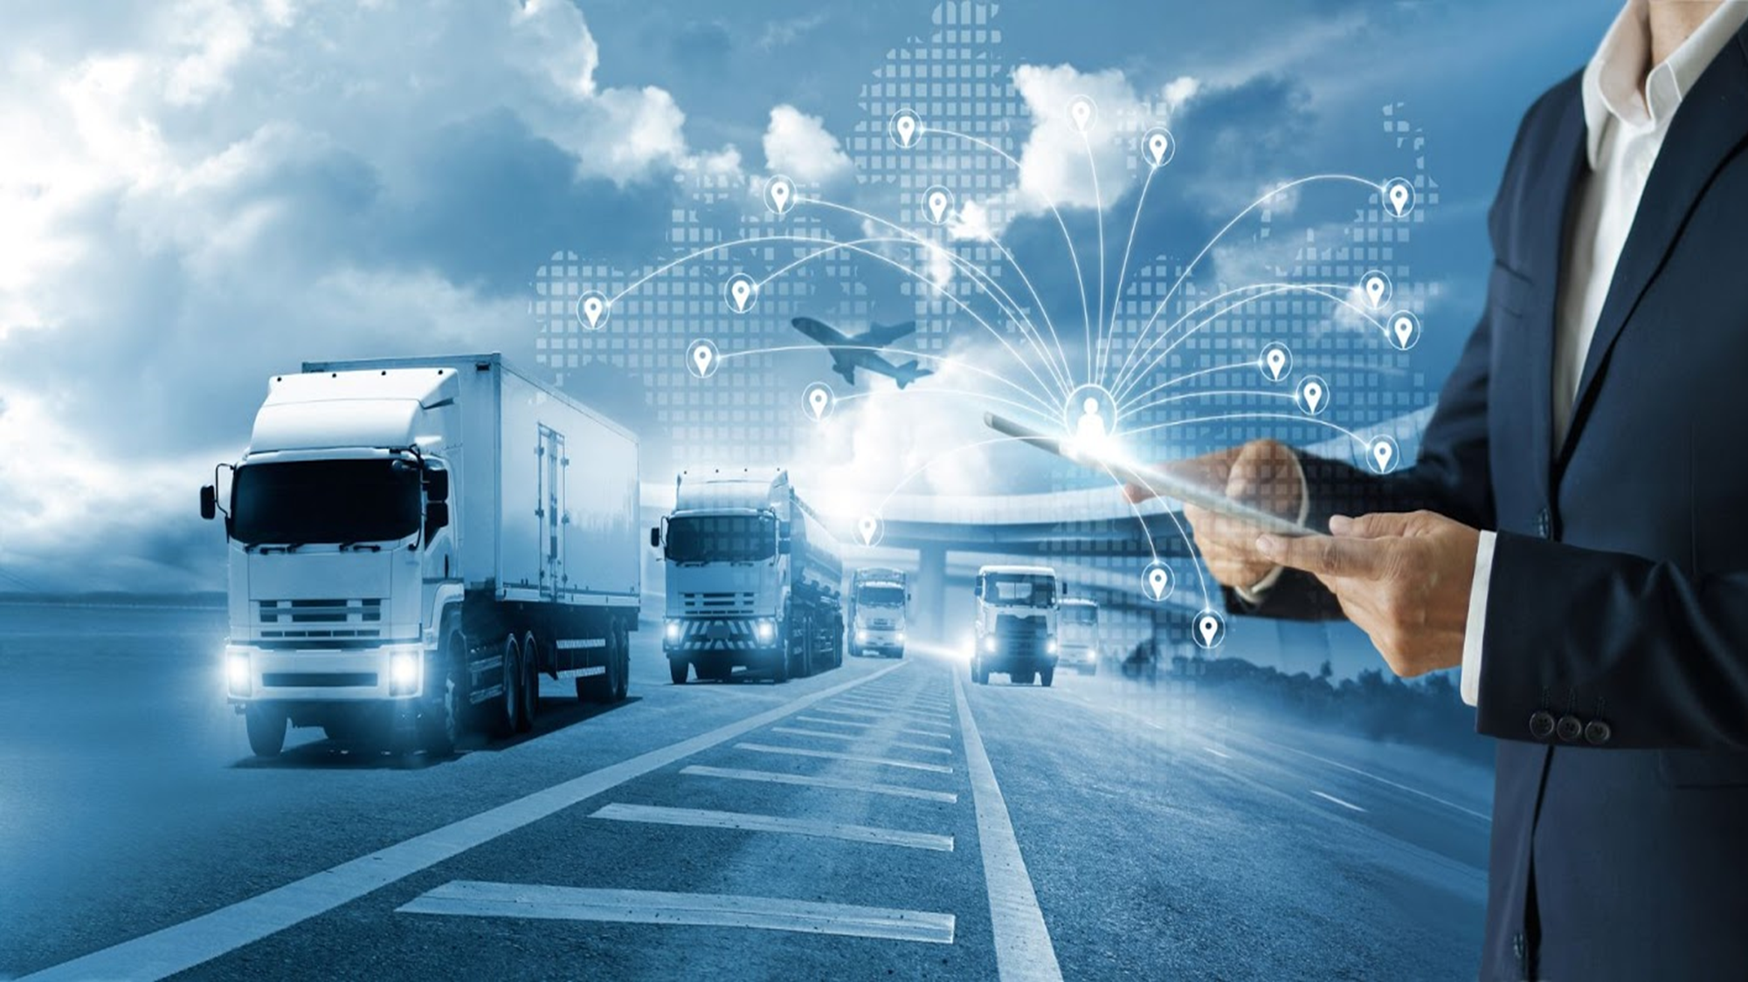
Modern Day Safety
Notes:
And this brings us to the Modern-day safety professional…

Slide 14
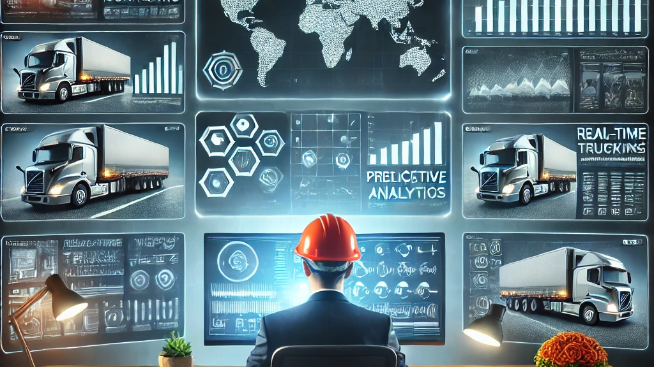
Modern Day Safety Professional
Notes:
That brings us to today. Typically, when talking about AI & technology the first thing that comes to mind is are we being replaced? Increased automation does eliminate some functions or tasks, however that does not mean safety professionals are not needed. The roles & responsibilities of a safety professional have changed into what we know today as the “modern-day safety professional”.
So, what exactly does a Modern-Day Safety Professional do?
We manage risk. But it’s an adaptation of risk management. We need to get with the times.
We manage risk through
Technology Integration:
Overseeing the implementation and management of technology integration.
Analyse the information to improve decision making
Transformation of Safety Professionals Roles:
Expanded Focus on Driver Behavior and Training:
AI systems offer detailed insights into driver behavior, helping to identify risky habits and areas for improvement.
Safety professionals can design tailored training programs based on individual driver data, promoting safer driving practices.
Improved Fleet Management:
AI enables real-time tracking of vehicle health and safety, allowing for immediate corrective actions.
Efficient scheduling and route planning minimize risks, reduce fuel consumption, and enhance overall fleet efficiency.
Enhanced Data-Driven Decision Making:
AI tools provide safety professionals with access to vast amounts of data, allowing for comprehensive risk assessments and informed decision-making.
Allows us to analyze & highlight trends
Automated reporting and compliance management reduce administrative burdens and enhance accuracy.

Slide 15
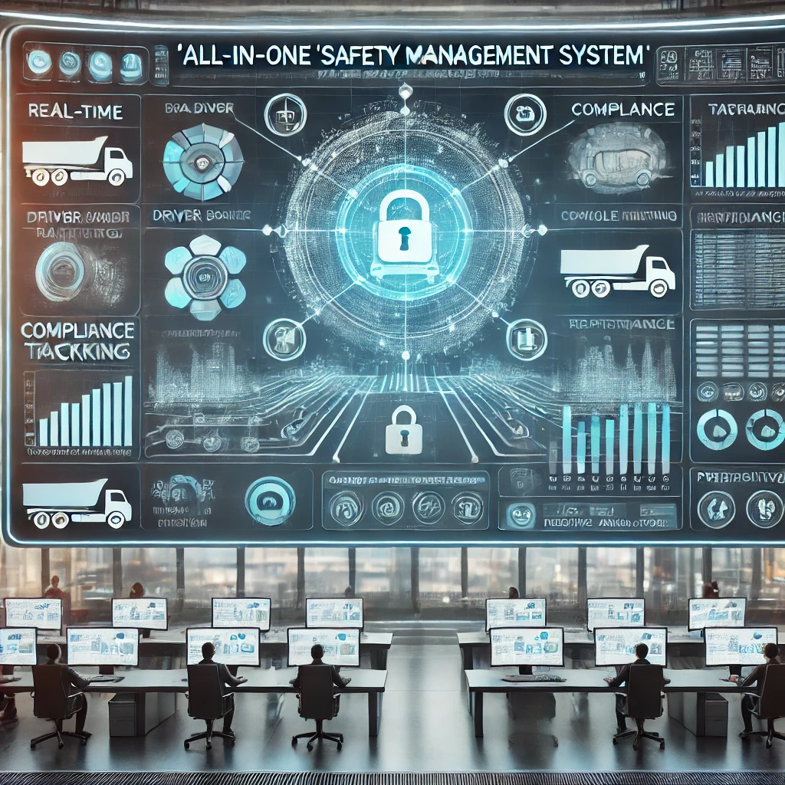
Modern Day Safety Management System
Notes:
Now that you know the role of a modern-day safety professional and what it entails. We need a system to tie all of this together. We’ll be exploring the impact the introduction of AI has on the safety management system:
Modern Safety Management System:
Uses Advanced Telematics w/ Computer vision systems monitor driver behavior, detect signs of fatigue, and identify distractions.
Single Pane Safety Management Systems:
- centralized data for comprehensive insights: Consolidates data from various sources, telematics, driver logs, incident reports, etc. Provides a holistic view of safety performance allowing for more accurate timely analysis.
Predictive Analytics:
Predictive Analytics: Leveraging predictive analytics to anticipate and prevent potential safety issues (mechanical failures, driver fatigue, vehicle accidents, injuries, etc.)
This is a proactive safety approach that not only allows to adapt real time but helps predict & prevents safety incidents.

Slide 16
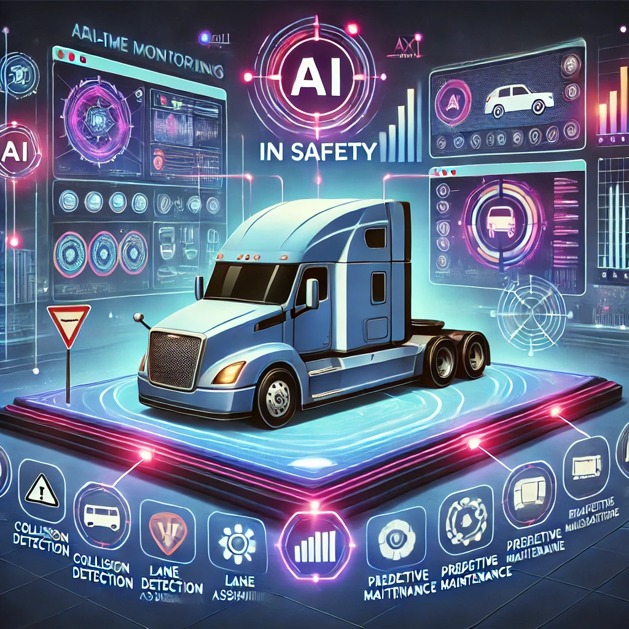
Benefits of AI-Driven Safety Practices
Notes:
Benefits of AI Driven Safety Practices
Increased Safety and Reduced Accidents:
Data-driven approaches have led to significant reductions in accidents, injuries, and fatalities in the trucking industry.
Real-time monitoring and proactive interventions help prevent safety incidents before they happen.
Cost Savings:
Reduced costs associated with accidents, fines, vehicle maintenance, and insurance premiums.
Optimized operations lead to fuel savings and extended vehicle lifespans.
Regulatory Compliance:
AI streamlines the process of meeting safety regulations and standards, reducing the risk of non-compliance penalties.
Enhanced Reputation and Trust:
A strong commitment to safety builds trust with customers, partners, and the public, enhancing the company's reputation.
Increased Safety and reduced accidents
Cost Savings
Regulatory Compliance
Enhanced Reputation and Trust

Slide 17
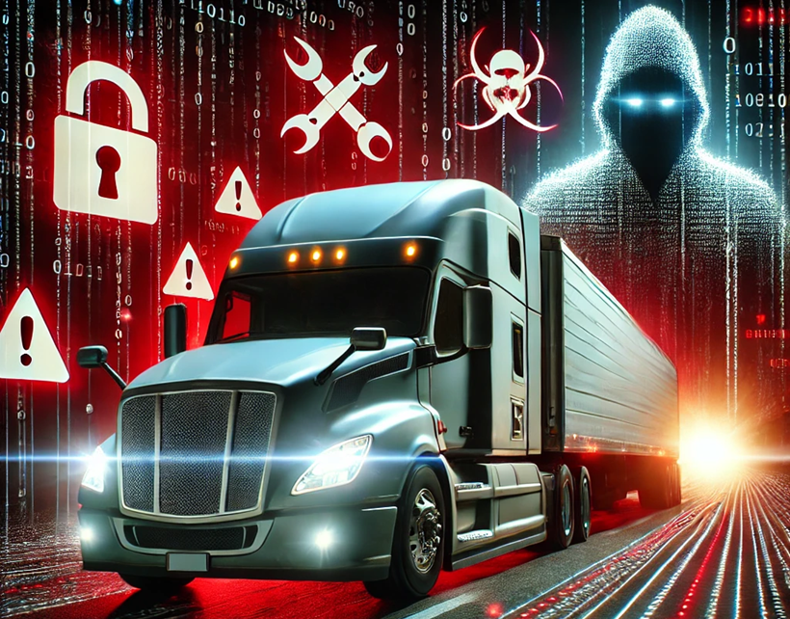
Challenges & Considerations
Notes:
Challenges & Considerations:
Rapid: Keeping up with the pace of technological change and ensuring that both the safety infrastructure and personnel are adequately trained and prepared to utilize these new tools effectively.
Systems Compatibility: Ensuring seamless integration across various platforms and systems to avoid data silos, which could undermine safety efforts by providing incomplete or inaccurate information.
Cyber attacks:
Challenge: Balancing the need for comprehensive data collection with the responsibility to protect individual privacy and comply with data protection regulations.
Talking Points:
Implementation Challenges:
The high cost and complexity of integrating AI technologies into existing systems.
The need for continuous training and adaptation to new tools and processes for both drivers and safety professionals.
Data Privacy and Security:
Concerns over the handling and protection of sensitive data collected by AI systems.
Ensuring that data usage complies with privacy regulations and ethical standards.
Balancing Human and AI Roles:
Despite technological advances, human oversight and judgment remain critical in safety management.
Safety professionals must balance leveraging AI insights with their expertise to make well-rounded decisions.

Slide 18
Future of AI in Trucking Safety
Emerging Technologies and Trends:
AI Driven Safety Enhancements
The development of autonomous trucks and “Pontoon Trucks”
AI Enhanced Fleet: Integration of AI with other advanced technologies like the Internet of Things (IoT) and 5G networks, enhancing connectivity and data flow.
AI in Compliance and Regulation
Workforce Transition and Human / AI Collaboration
Evolving Role of Safety Professionals:
As AI continues to evolve, safety professionals must develop new skills in data analysis, technology management, and ethical decision-making.
The role will increasingly focus on strategic planning, risk management, and continuous improvement of safety practices
Notes:
The future of the trucking industry is poised for significant transformation due to the integration of artificial intelligence (AI) across various operations. AI is expected to streamline logistics, enhance safety, and eventually lead to autonomous trucking, which will have profound effects on the role of safety managers.
1. AI-Driven Safety Enhancements
AI systems are increasingly being used to monitor and improve the safety of trucking operations. Technologies such as advanced driver assistance systems (ADAS), collision avoidance, lane-keeping assistance, and fatigue detection are already making trucks safer. AI-powered dashcams and sensors can analyze driver behavior in real-time, alerting drivers to dangerous habits and automatically correcting them, such as braking or lane changes. This not only reduces accidents but also provides valuable data to safety managers.
Impact on Safety Managers: Safety managers will rely more on data-driven insights provided by AI to monitor driver performance, identify patterns in unsafe behaviors, and take preemptive actions. Their role will shift from reactive to proactive, using AI analytics to forecast potential risks and implementing solutions before accidents occur.
2. Autonomous Trucks and Long-Term Changes
Autonomous trucks, powered by AI, are already being tested and could eventually handle a significant portion of long-haul transportation. AI algorithms, combined with sensors, cameras, and radar, allow these trucks to drive with little or no human intervention, reducing the risk of human error—one of the biggest contributors to road accidents. Fully autonomous trucks will likely start in controlled environments like highways, but the technology will eventually expand.
Impact on Safety Managers: In the age of autonomous trucks, the role of safety managers will evolve from overseeing human drivers to ensuring the safety of the AI systems that drive the vehicles. Safety managers will need to ensure that AI systems are functioning correctly, are updated regularly, and that there are backup systems in place to prevent malfunctions. Managing cybersecurity risks and compliance with evolving regulations around autonomous driving will also become a critical aspect of their job.
3. AI-Enhanced Fleet Management
AI will play a significant role in fleet management by optimizing routes, monitoring vehicle health, and predicting maintenance needs. AI can analyze vast amounts of data, including weather, traffic, and road conditions, to provide optimal routes that reduce travel time and fuel consumption while enhancing safety. Predictive maintenance systems, powered by AI, can detect when a part is likely to fail and schedule repairs before it becomes a safety hazard.
Impact on Safety Managers: Safety managers will use AI-powered tools to better maintain fleets and prevent breakdowns that could cause accidents. Their responsibilities will expand to include oversight of these predictive systems, ensuring they are correctly calibrated and used effectively.
4. AI in Compliance and Regulation
The use of AI in regulatory compliance will grow, particularly in areas like electronic logging devices (ELDs), hours-of-service (HOS) tracking, and environmental regulations. AI can monitor and automatically ensure compliance with complex safety regulations, reducing the administrative burden on safety managers.
Impact on Safety Managers: With AI handling much of the day-to-day compliance tasks, safety managers will focus more on strategic oversight, such as implementing new safety initiatives and staying updated on evolving laws and AI-driven regulations.
5. Workforce Transition and Human-AI Collaboration
AI will change the workforce landscape in the trucking industry. While autonomous trucks may reduce the need for drivers, new roles will emerge in overseeing AI systems and managing exceptions that AI cannot handle. Human drivers will still be critical for short-haul deliveries, complex urban routes, and situations where human judgment is needed.
Impact on Safety Managers: Safety managers will need to ensure a smooth transition as the workforce adapts to AI integration. They will be responsible for training staff on how to interact with AI systems and ensuring that human drivers and AI work together efficiently. They will also have to manage a hybrid fleet of both human-driven and autonomous trucks, ensuring safety across both platforms.
Conclusion:
AI will revolutionize the trucking industry, enhancing safety, efficiency, and operational precision. Safety managers will see their roles evolve from managing human drivers to overseeing AI systems and ensuring the safe integration of advanced technologies. While AI will automate many tasks, human oversight will still be crucial, especially in managing AI-driven systems, maintaining compliance, and mitigating new forms of risk (e.g., cybersecurity). This shift requires safety managers to adapt by learning new technologies, focusing on system safety, and preparing for a more data-driven, tech-oriented future in trucking.

Slide 19
The Outline for this presentation was created, in part, by Generative AI tools
But don’t just take our word for it…
Notes:
We have covered a lot of information over the last hour and you may be thinking “wow, those two guys really know a lot of stuff”… and while that is true, we don’t want you to just take our word for it. Generative AI – Chat GPT – even helped us transform our presentation skills but creating, in part, the outline and many of the images for the discussion here today.

Slide 20
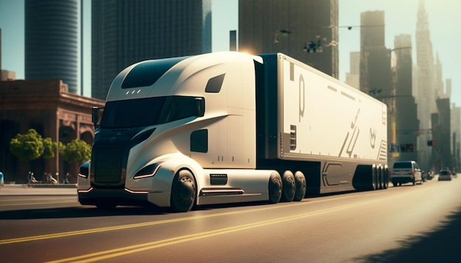
Conclusion
Notes:
AI has transformed the role of safety professionals from reactive enforcers to proactive risk managers in the trucking industry. The integration of AI technologies has led to increased safety, cost savings, and compliance, but it also presents challenges that need careful consideration.
While AI offers significant benefits, it should complement, not replace, human expertise and judgment in safety management. Safety professionals must continue to adapt and embrace new technologies to enhance their roles and contribute to a safer trucking industry.
We would like to encourage all your companies and you as safety professionals to proactively adopt AI technologies and invest in training and development to maximize the benefits of AI in safety management. Our jobs are not disappearing, they are however evolving.

Slide 21
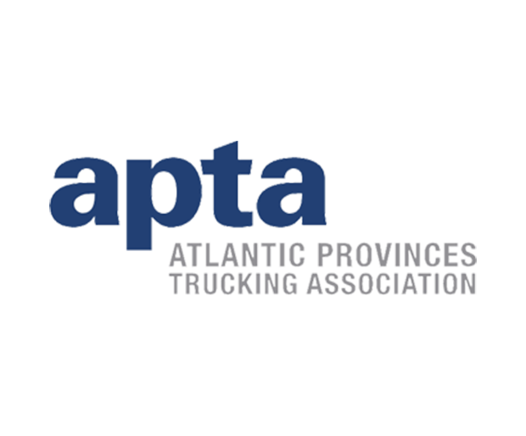
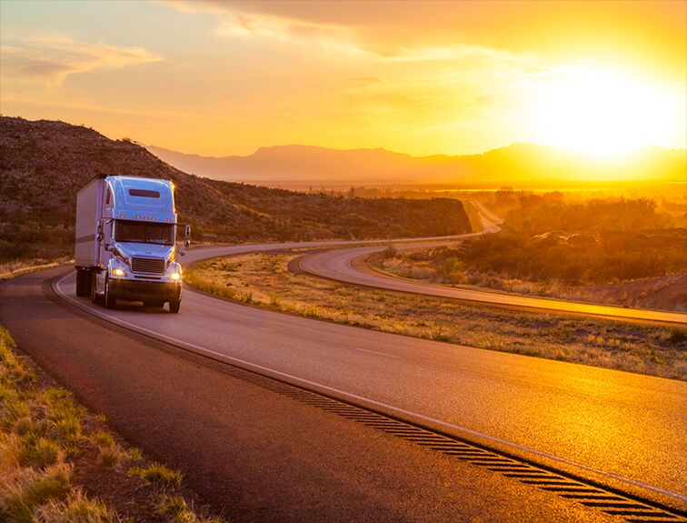
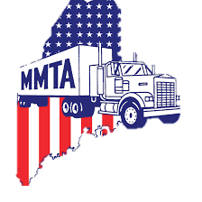
Q&A Session
Thank you
Contacts:
Nick Michaud - michaud.nicholas@midlandtransport.com
Shawn Reilly – reilly.shawn@rsttransport.com
Notes:
Q&A Session
Open the floor for questions and discussions.
Encourage audience engagement by inviting them to share their thoughts and experiences with AI in safety management.

