Slide 1
September 23, 2024
Dennis Anderson
Safety Investigator
Maine Division

Slide 2
Agenda Topics
Clearinghouse Background
High-Level Clearinghouse User Roles
Queries and Consent
Violation Reporting
Clearinghouse Statistics and RTD
Impacts on FMCSA Operations
FAQs
Clearinghouse II Rule

Slide 3
Overview of the Clearinghouse
Notes:
.

Slide 4
The Clearinghouse First Final Rule
Mandated by Congress (MAP-21, Section 32402)
Published December 5, 2016
Established requirements for the Clearinghouse
Implemented on January 6, 2020
Learn more and access the Clearinghouse first final rule at:
www.fmcsa.dot.gov/regulations/commercial-drivers-license-drug-and-alcohol-clearinghouse

Slide 5
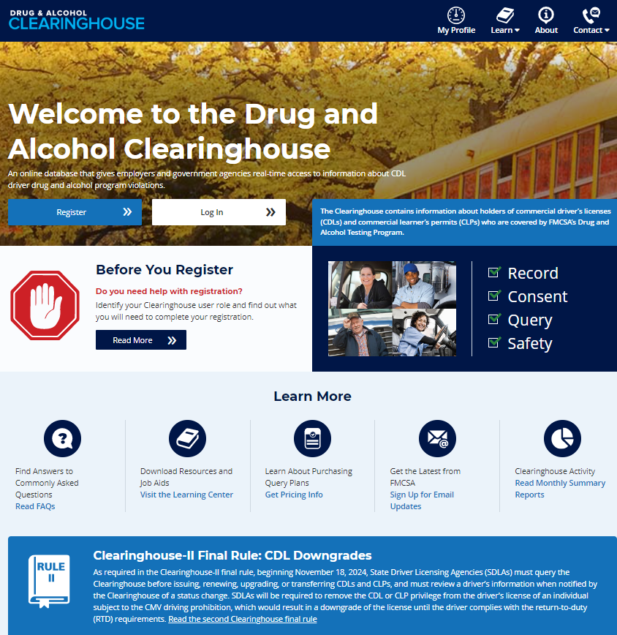
FMCSA CDL Drug and Alcohol Clearinghouse
The Drug and Alcohol Clearinghouse prevents impaired operation of CMVs by giving employers access to real-time information about which CDL drivers have drug and alcohol program violations, enabling employers to determine which drivers to remove from safety-sensitive functions.
Verified positive drug test
Alcohol test 0.04 or greater BAC
Refusal to test
Actual knowledge of a drug and alcohol program violation

Slide 6
Who is required to use the Clearinghouse?
Drivers who hold commercial driver’s licenses (CDLs) or commercial learner’s
permits (CLPs)
Employers of CDL drivers who operate commercial motor vehicles (CMVs)
Consortia/Third-Party Administrations (C/TPAs)
Medical Review Officers (MROs)
Substance Abuse Professionals (SAPs)
State Drivers Licensing Agencies (SDLAs)

Slide 7
User Roles

Slide 8
Employer Requirements
Register
Record
Query
Designate
Link to your FMCSA Portal account (optional)
Report CDL driver drug and alcohol program violations
Positive alcohol tests, test refusals, actual knowledge
Check if driver is prohibited from operating a CMV
Pre-employment and annual
Designate a C/TPA (optional)
C/TPA may conduct queries, report violations and RTD information on your behalf

Slide 9
Driver Requirements
Register
Consent
Designate
Be sure to verify your CDL
Needed to view Violation History, respond to query consent requests, and designate a SAP
Respond to consent requests for full queries from current and potential employers
Note: All pre-employment queries are full queries
This includes positive tests, test refusals, and actual knowledge
Designate a SAP, if needed, to record RTD information
Failure to provide consent to a request for a full query will result in the driver being prohibited from performing safety-sensitive functions (including operating a CMV) for that employer, in accordance with § 382.703(c).

Slide 10
MRO and SAP Requirements
Register
Report
MRO
Self-certify you meet all MRO qualifications per § 40.121
Positives and test refusals (e.g., adulterated and substituted)
Self-certify you meet all SAP qualifications per § 40.281
Driver must designate you in the Clearinghouse
Enter RTD information: date of initial SAP assessment, and date driver determined eligible for RTD testing
SAP

Slide 11
Queries and Consent Requests

Slide 12
Query Requirement
A query is a check of the Clearinghouse to ensure a CDL driver is not prohibited from performing safety-sensitive functions (such as operating a CMV) due to a drug and alcohol program violation
All queries require driver consent
Query Type | Description
Pre-employment query | Required for all newly hired CDL drivers
Annual query | Follows a rolling 12-month calendar Example: A query on driver J. Smith on December 1, 2022 satisfies the annual query requirement for J. Smith until December 1, 2023

Slide 13
Consent Requirements Based on Type of Query
Reason for Query | Type of Query | Consent Required
Annual query | Limited query | General consent, done outside the Clearinghouse May be electronic or wet signature, one time or unlimited Limited consent form must specify time range
Pre-employment query | Full query | Specific consent, provided electronically within the Clearinghouse Required for each full query of an individual driver
Download a sample general consent form.
If a driver refuses consent for any query, the query cannot be conducted and the driver is prohibited from performing safety-sensitive functions for that employer.

Slide 14
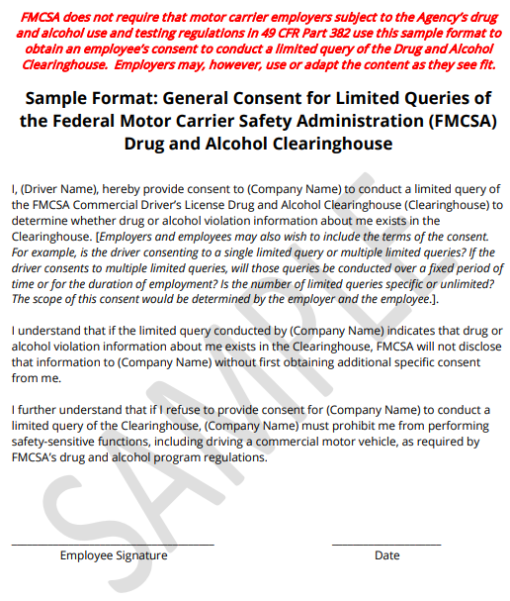

Slide 15
Notification of New Information
If information is entered or modified in a driver’s Clearinghouse record within 12 months of a previous query on that driver, the employer will be notified via email.
The Query History will also be updated to reflect this
A follow-on query is needed to determine if the new information results in the driver having a “prohibited” Clearinghouse status
Click Send Consent Request to request driver consent for the follow-on query
Employer is not charged for a follow-on query

Slide 16
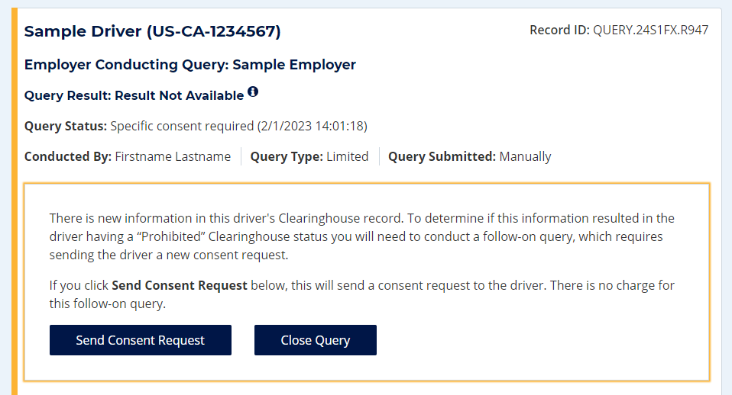
Notification of New Information

Slide 17
Follow-on Query
Reason for Query | Type of Query | Consent Required
Follow-on query | Full query | Specific consent, provided electronically within the Clearinghouse
Employer should complete follow-on query within 24 hours.
If a driver refuses consent, the query cannot be conducted and the driver is prohibited from performing safety-sensitive functions for that employer.
“New information” is not necessarily a notification that a queried driver is prohibited from performing safety-sensitive functions. The full query is needed to determine the driver’s eligibility status.

Slide 18
Violation Reporting

Slide 19
Reporting Violations – Employers and C/TPAs
What is the employer or designated C/TPA required to report?
REPORTING ENTITY | INFORMATION TO BE REPORTED TO CLEARINGHOUSE (must be reported by close of the third business day following the date the employer obtained the information)
Prospective/Current Employer of CDL Driver Or Service agent acting on behalf of Current Employer of CDL Driver | An alcohol confirmation test with a concentration of 0.04% or higher
 | Refusal to test (alcohol) as specified in 49 CFR 40.261
 | Refusal to test (drug) not requiring a determination by the MRO as specified in 49 CFR 40.191
 | Actual knowledge, as defined in 49 CFR 382.107, that a driver has used alcohol on duty, used alcohol within four hours of coming on duty, used alcohol prior to post-accident testing, or has used a controlled substance
 | Negative RTD test results (drug and alcohol testing, as applicable)
 | Completion of follow-up testing

Slide 20
Reporting Violations – MROs and SAPs
What information is the MRO or SAP required to report?
 | INFORMATION TO BE REPORTED TO CLEARINGHOUSE | DEADLINE FOR REPORTING INFORMATION
MRO | Verified positive drug test result | Within two business days of making a determination or verification of a DOT-approved drug test
 | Refusal to test (drug) requiring a determination by the MRO as specified in § 40.191
 | Changes a verified drug test per part § 40.149 | Within one business day of making any change in the reported results
SAP | Identification of driver and date the initial assessment was initiated | By the close of the business day following the date of initial assessment
 | Date of determination of eligibility for RTD testing | By the close of the business day following the determination that the driver completed the RTD process

Slide 21
Statistics
https://clearinghouse.fmcsa.dot.gov/

Slide 22
Program Statistics: Registrations
The number of CDL/CLP holders (drivers) and organizations registered within the Clearinghouse by role type since September 28, 2019

Slide 23
Program Statistics: Queries

Slide 24
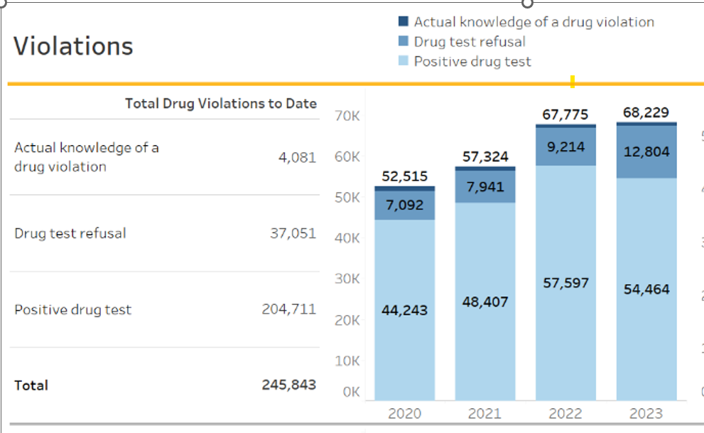
Program Statistics: Types of Violations

Slide 25
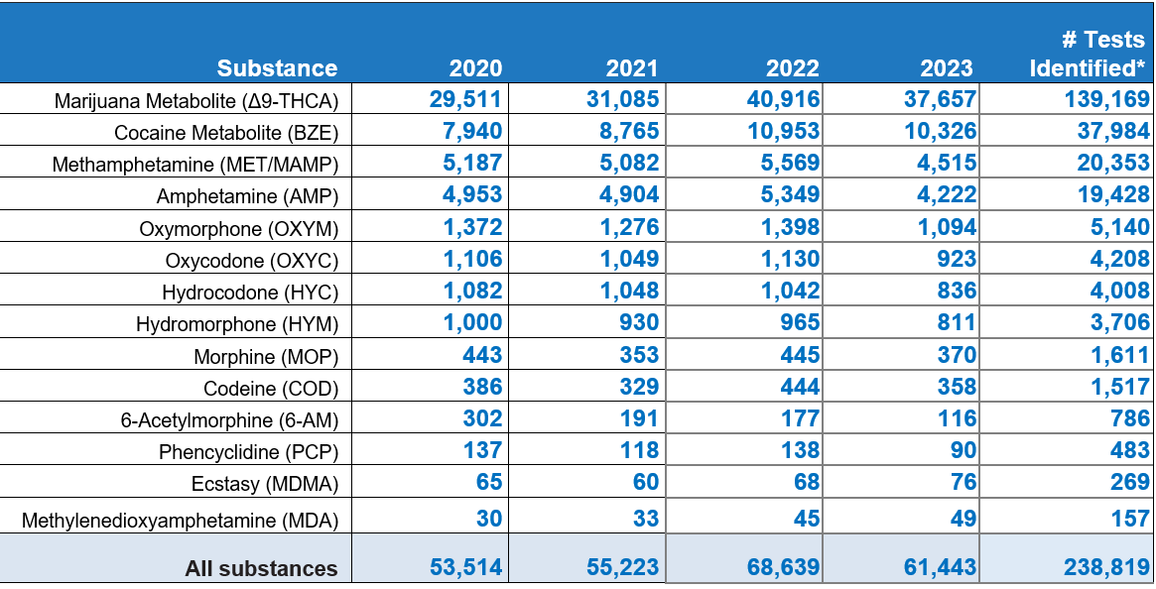
Drug Violation Data as of January 1, 2024
Substances Identified in Positive Drug Tests

Slide 26
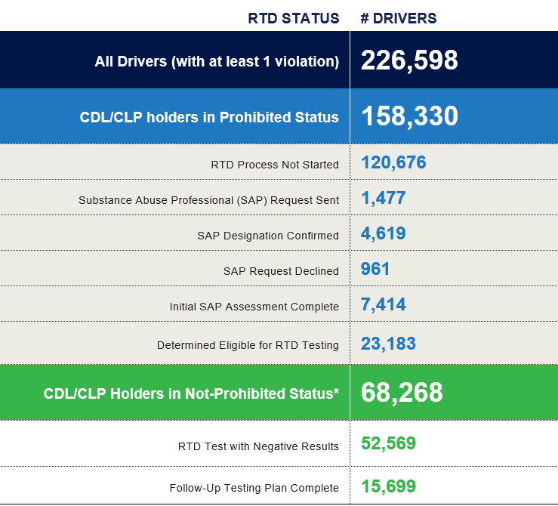
Individual Driver Status as of January 1, 2024

Slide 27
Return-to-Duty (RTD) Process
A driver with a drug and alcohol program violation is prohibited from performing safety-sensitive functions, including operating CMVs, for any DOT-regulated employer until the RTD process is complete.
The steps drivers must take to complete the RTD process is established by 49 CFR part 40, subpart O, as follows:
1
Select a Substance Abuse Professional (SAP) and successfully complete education/ treatment plan.
2
Take the return-to-duty test.
3
When employer or C/TPA enters negative RTD test, Clearinghouse status changes to “not prohibited” and driver is eligible to resume performing safety-sensitive functions.
By November 18, 2024, as part of new Federal regulations, drivers with a “prohibited” status in the Clearinghouse will lose or be denied their State-issued commercial driving privileges.

Slide 28
Clearinghouse and FMCSA Operations

Slide 29
Clearinghouse Administrative Functions
Clearinghouse Administrative Functions | Estimates Per Day or Week
Driver Petition for Review of Violations per 382.717(a) | 150-200 received weekly
Driver Requests for Administrative Review of Petition decision per 382.717(f) | 5-10 received weekly
Driver Petitions for Review of Violations under the Privacy Act (49 CFR Part 10) | 1 per week
Clearinghouse Call Center Calls/E-mails | 800 calls/150 emails per day
Violation Delete Requests (MRO and Employer) | 100 received weekly
Return to Duty and Follow Up Delete Requests | 50 received weekly
SAP Change Requests | 25 received weekly
Clearinghouse Public Inbox | 90 received per day
SDLA Dedicated Inbox for Clearinghouse II | TBD

Slide 30
The Clearinghouse Spotlight
FMCSA utilizes Clearinghouse Data with Roadside Inspection and Crash Data to identify carriers using prohibited drivers
Investigations are being conducted nationally
Correlation between Clearinghouse compliance and Prohibited Driver Use
Civil Fines levied
Identifying non-compliant Third-Party Service Agents
Through investigations and driver complaints
SAPs
MROs
Collection sites
C/TPAs

Slide 31
Service Agent Interaction with FMCSA Field personnel
Third Party Service Agent Reviews
Increased need for:
SAP reviews
MRO inquiries
Collection Site Reviews
FMCSA goal to train more investigators in these types of reviews

Slide 32
FAQs
Notes:
Devin Eakes

Slide 33
Common Questions – Medical Marijuana
DOT Medical Marijuana Notice
https://www.transportation.gov/odapc/medical-marijuana-notice
The Department of Transportation’s Drug and Alcohol Testing Regulation – 49 CFR Part 40, at 40.151(e) – does not authorize “medical marijuana” under a state law to be a valid medical explanation for a transportation employee’s positive drug test result.

Slide 34
Common Questions - Prescriptions
Can FMCSA remove a positive drug test violation from the Clearinghouse based on a driver’s prescription?
No. Under 49 CFR 40.149, only the MRO would request removal of a violation from the Clearinghouse if they determine that there is a valid medical explanation for a positive test result—not FMCSA.
Will a prospective employee’s drug and alcohol violation history with other DOT modes be available in the Clearinghouse?
No, the Clearinghouse will contain only drug and alcohol program violation information for employees subject to the testing requirements under the Federal Motor Carrier Safety Regulations in 49 CFR part 382.

Slide 35
FAQs – Other Modes and Non-CDL Drivers
Are employers of non-CDL drivers who operate CMVs required to query or report violations to the Clearinghouse?
No. Only employers who employ drivers subject to 49 CFR parts 382 and 383 must query or report information to the Clearinghouse.

Slide 36
Clearinghouse II Rule Implementation
Notes:
Devin Eakes

Slide 37
Reminder: Clearinghouse-II SDLA Requirements
Mandatory CDL Downgrade
Non-Issuance
Remove CLP or CDL privilege within 60 days of being notified by FMCSA of a driver’s prohibited status in the Clearinghouse
If notified by FMCSA that a driver’s status changed to “not prohibited”
Terminate CLP/CDL privilege removal process; or
Reinstate the previously-removed CLP/CLP privilege
If notified by FMCSA that a driver’s prohibited status was due to erroneous entry, reinstate as soon as possible and expunge driving record
Query Clearinghouse prior to commercial licensing transaction
Deny commercial licensing transaction if Clearinghouse query shows driver in a prohibited status​
Commercial licensing transaction = issuing, duplicates, renewing, transferring, or upgrading a CDL or issuing, renewing, or upgrading a CLP
Beginning
NOVEMBER
18
2024
Notes:
Devin Eakes
As a reminder, here are the SLDA requirements under Clearinghouse-II final rule.​
​
Once again, the compliance date is later THIS YEAR, on November 18, 2024.

Slide 38
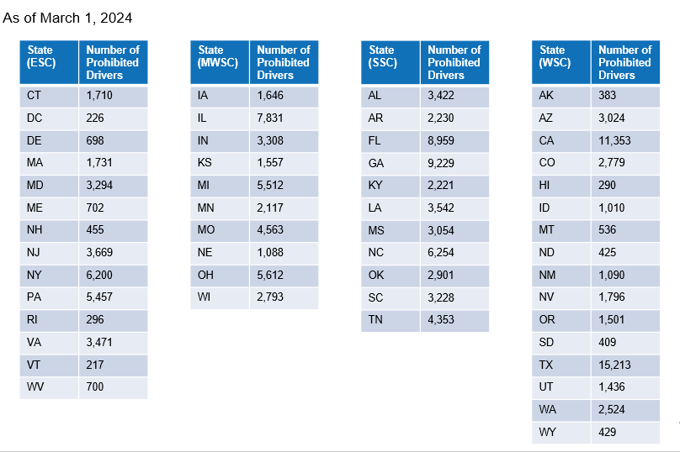
Number of Currently Prohibited Drivers In Each State

Slide 39
CDL Downgrades: Timeline
Pre-Compliance Date
Compliance Date (November 18, 2024)
Post-Compliance Date
SDLAs with legislative authority may begin downgrading CDLs for drivers with a “prohibited” Clearinghouse status
Pull Prohibited Drivers Report to identify prohibited drivers
Pull Driver Status Change Report to track reinstatements
SDLAs must downgrade CDLs for drivers with a “prohibited” Clearinghouse status
Within 60 days from FMCSA notification
Includes all historic prohibitions (violations entered since January 6, 2020, still open) – SDLAs must pull report
SDLAs must continue to downgrade CDLs for drivers with a “prohibited” Clearinghouse status
Within 60 days from FMCSA notification
Once State backlog is cleared, will only need to address new/current prohibitions

Slide 40
Resources
Where can I learn more about the
Clearinghouse-II final rule?
Visit
SDLA Resources: https://clearinghouse.fmcsa.dot.gov/Resource/Page/SDLA-Resources
Drug and Alcohol Clearinghouse: https://clearinghouse.fmcsa.dot.gov/
Contact
Clearinghouse Team: SDLAclearinghouse@dot.gov
https://clearinghouse.fmcsa.dot.gov/Contact

Slide 41
Questions?
For more information:
Visit the Clearinghouse Learning Center at: https://clearinghouse.fmcsa.dot.gov/Learn for resources and answers to common questions
Contact us:
Email clearinghouse@dot.gov
Call 844-955-0207

Slide 42
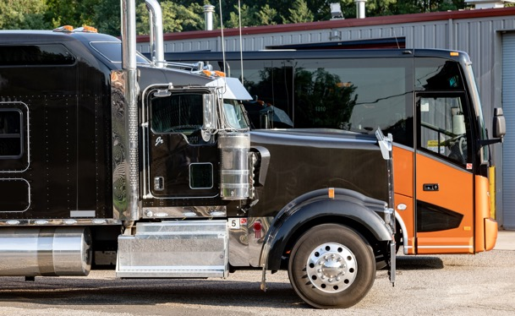
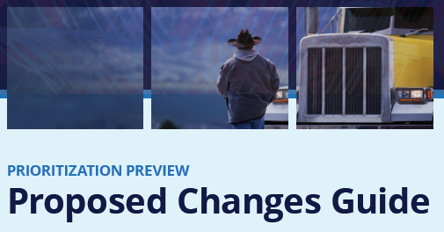
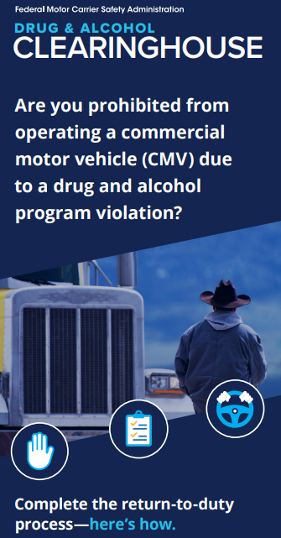
FMCSA Update Proposed SMS Changes
April 24, 2024
Notes:
Available cover design option. Please delete any unneeded cover page designs.

Slide 43
What is NEW in this proposed SMS change?
Reorganized BASICs
Reorganized Roadside Violations
Simplified Severity Weights
Improved Intervention Thresholds
Proportionate Percentiles
Greater Focus on Recent Violations
Updated Utilization Factor
New Segmentation
Accounting for Non-Preventable Crashes

Slide 44
What is NEW in this proposed SMS change?
Reorganized BASICs
The term BASICs is being replaced by SAFETY CATEGORIES
Reorg the Unsafe Driving and Vehicle Maintenance Safety Categories
Unsafe Driving will include
Drug and Alcohol violations
ALL Operating after OOS violations
Notes:
No longer their own BASIC
Example 396.9(c)(2) OOS veh

Slide 45
What is NEW in this proposed SMS change?
Reorganized BASICs
The term BASICs is being replaced by SAFETY CATEGORIES
Reorg to the Unsafe Driving and Vehicle Maintenance Safety Categories
Vehicle Maintenance will include
Driver Observed
Vehicle Maintenance
Notes:
No longer their own BASIC
Example 396.9(c)(2) OOS veh

Slide 46
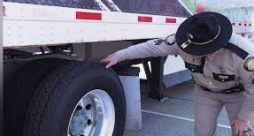
What is NEW in this proposed SMS change?
Reorganized Roadside Violations
From 959 roadside violations to 116 VIOLATION GROUPS
All 959 can still be cited roadside, for prioritization purposes, similar violations would be grouped, all violations written will appear on the inspection report and be found in the system…
If a MC was cited for 2 or more violations in a violation group during a roadside, then SMS would treat that set of violations as ONE when calculating the carrier’s safety measure in that Safety Category
Example – HOS violations on one inspection, 11, 14, 60/70 and no 30 minute break
Notes:
No longer their own BASIC
Example 396.9(c)(2) OOS veh

Slide 47
What is NEW in this proposed SMS change?
Simplified Severity Weights
Moving from a scale of 1 – 10 based on the violation to:
A scale of 1 or 2 based on the violation group
2 points earned –
One or more violations in a violation group if:
Violations are OOS (except Unsafe Driving)
Driver Disqualification violations apply to Unsafe Driving Safety Category 383.51
1 point – if none of the violations in a set are OOS or Driver DQ…1 point assigned
Notes:
No longer their own BASIC
Example 396.9(c)(2) OOS veh

Slide 48
What is NEW in this proposed SMS change?
Proportionate Percentiles
Using the EXACT number of inspections and crashes rather than number within the safety event group
Customizes percentile to exact number of carrier events
Gradual increases or decreases month to month
Carrier’s changes in measure will have a greater influence on percentile changes
Allows FMCSA to compare similar carriers to similar carriers
Better trend analysis for carriers month to month
Notes:
No longer their own BASIC
Example 396.9(c)(2) OOS veh

Slide 49
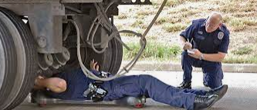
What is NEW in this proposed SMS change?
Greater Focus on Recent Violations
Only prioritizes assignments if the carrier has data within the last 12 months
Applies to the following Safety categories
HOS
Vehicle Maintenance
VM Driver Observed
HM
Driver Fitness
Notes:
No longer their own BASIC
Example 396.9(c)(2) OOS veh

Slide 50
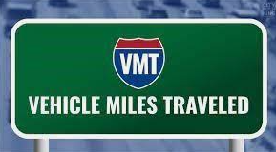
What is NEW in this proposed SMS change?
Updated Utilization Factor
Utilization factor moving from 200,000 VMT to
250,000 VMT
More accurate measures focuses agency resources on carriers most in need of intervention
Notes:
No longer their own BASIC
Example 396.9(c)(2) OOS veh

Slide 51
What is NEW in this proposed SMS change?
New Segmentation
Current SMS only segments Unsafe and Crash BASICs
Proposed changes in segments - the above and:
HM – Cargo Tank and non-CT carriers
Driver Fitness
Straight Truck
Combination
Notes:
No longer their own BASIC
Example 396.9(c)(2) OOS veh

Slide 52
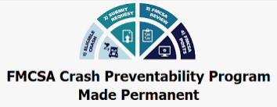
What is NEW in this proposed SMS change?
Non-preventable Crashes
Proposed SMS changes will continue to exclude from measurement the determined non-preventable crashes and will add those to the Pre-employment Screening Program
SMS and prioritization is an evolving process – as we listen and learn we can adapt and adjust
Data to information, information to Action, Action to saving lives!
Notes:
No longer their own BASIC
Example 396.9(c)(2) OOS veh

Slide 54
https://csa.fmcsa.dot.gov/prioritizationpreview
Notes:
Check out how you will look under the new proposal

Slide 55
Questions?

